Slide 1

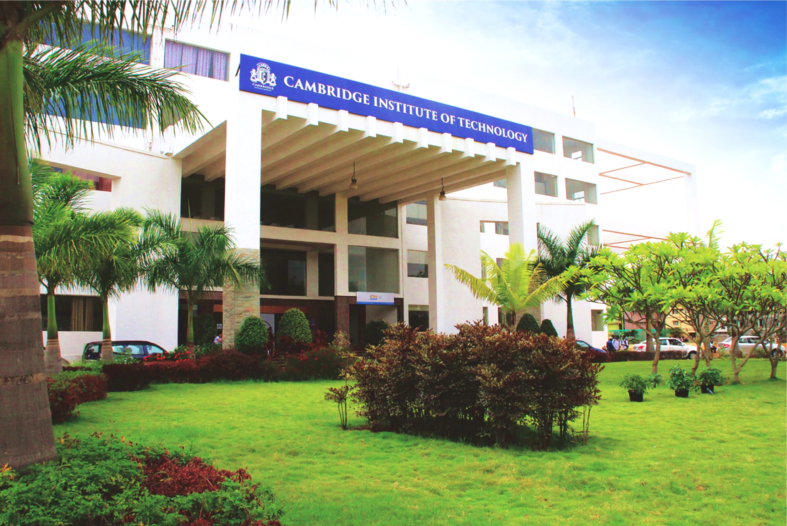
www.cambridge.edu.in
Mini Project
Subject Code: 21AIMP67
Project Name:
LANGUAGE TRANSLATER BOT
Presented By :
ABHISHEK SURYAVANSHI : 1CD21AI002
SRINIDHI M NEGINAHAL : 1CD21AI054
Department of Artificial Intelligence and Machine Learning

Slide 2
Abstract:-
A language translator bot is an automated system designed to translate text from one language to another . The bot can understand and interpret the context of the text, ensuring accurate and coherent translations. The bot supports multiple languages, allowing for seamless communication across different linguistic backgrounds. Key features include high-speed processing, user-friendly interfaces, and adaptability to various communication platforms such as chat applications, websites, and mobile apps. This technology aims to bridge language barriers, enhancing global communication and fostering greater understanding in diverse environments, including business, education, travel, and social interactions.
Department of Artificial Intelligence and Machine Learning www.Cambridge.edu.in

Slide 3
Introduction:-
A text translator bot is an intelligent tool designed to automatically translate text from one language to another. Using advanced technologies such as natural language processing (NLP) and machine learning, the bot can quickly and accurately convert text, ensuring the meaning and context are preserved. This technology supports multiple languages, making it a valuable resource for communication in today's globalized world. Whether integrated into chat applications, websites, or mobile platforms, the text translator bot enhances accessibility and understanding across different linguistic groups. By breaking down language barriers, it facilitates smoother interactions in various settings, including business, education, travel, and everyday social exchanges. The text translator bot represents a significant advancement in artificial intelligence, offering a practical solution for real-time language translation and promoting more inclusive and effective communication.
Department of Artificial Intelligence and Machine Learning www.Cambridge.edu.in

Slide 4
Problem Statement :-
“Develop a language translator bot that accurately translates text between multiple languages.”
Department of Artificial Intelligence and Machine Learning www.Cambridge.edu.in

Slide 5
Objectives:-
Achieve High Translation Accuracy: Develop algorithms that ensure precise translation of text and speech across multiple languages, minimizing errors and maintaining the original meaning.
Ensure Real-Time Performance: Optimize the system to provide low-latency, real-time translations for seamless communication, even in noisy environments.
Enhance User Experience: Design an intuitive and user-friendly interface that can be easily navigated by individuals with minimal technical knowledge.
Expand Language Support: Include support for a wide range of languages, including minority and endangered languages, to promote linguistic diversity and inclusivity.
Cost-Effective Implementation:Design a solution that is affordable for educational institutions and other sectors, making high-quality translation accessible to a broader audience.
Department of Artificial Intelligence and Machine Learning www.Cambridge.edu.in

Slide 6
Literature survey:-
SL NO | PAPER TITLE | JOURNAL NAME | DESCRIPTION | PROS | CONS
1 | A Comprehensive Survey on Real-Time Speech Translation Technologies | IEEE Transactions on Audio, Speech, and Language Processing | This paper reviews the latest advancements in real-time speech translation technologies, focusing on algorithms, applications, and performance metrics. | Extensive review of current technologies, practical applications, and future research directions. | May be highly technical, requiring a background in signal processing and machine learning.
2 | Neural Machine Translation: A Review | Journal of Artificial Intelligence Research | The paper surveys neural machine translation (NMT) techniques, discussing their evolution, architecture, and impact on translation accuracy. | Detailed analysis of NMT methods, comparison with traditional methods, insights into state-of-the-art models. | Focuses mainly on text translation, less emphasis on speech translation
Department of Artificial Intelligence and Machine Learning www.Cambridge.edu.in

Slide 7
Literature survey:-
SL NO | PAPER TITLE | JOURNAL NAME | DESCRIPTION | PROS | CONS
3 | A Review Of Mobile Translation Apps: Enhancing Communication in Multilingual Context. | ACM Computing Surveys | The paper reviews various mobile translation applications, evaluating their usability, performance, and user satisfaction. | Practical insights into popular mobile apps, user-centric evaluation, recommendations for improvement. | Limited to mobile applications, may not cover standalone translation devices or enterprise solutions.
4 | Challenges and Opportunities in Multilingual Natural Language Processing | Annual Review of Linguistics | This paper explores the challenges in multilingual NLP and the opportunities for developing more effective translation systems. | Broad overview of multilingual NLP challenges, interdisciplinary approach, forward-looking research agenda. | Broad scope may lack depth in specific translation technologies, more theoretical than practical.
Department of Artificial Intelligence and Machine Learning www.Cambridge.edu.in

Slide 8
System requirement analysis:-
Operating System: Compatible with Windows 8, macOS 10.12, or Ubuntu 18.04 LTS.
Processor: Intel Core i3 or AMD Ryzen 3 processor.
RAM: 2 GB RAM.
Storage: 500 MB available space.
Internet: Required for initial activation and updates.
Department of Artificial Intelligence and Machine Learning www.Cambridge.edu.in

Slide 9
System architecture:-
Text Input
Language Selection
Translate into Given Language
Convert The Text
Final Output Of Translated Language
Department of Artificial Intelligence and Machine Learning www.Cambridge.edu.in

Slide 10
Methodology:-
Identify User Needs: Understand the needs of target users, such as travelers, students, and business professionals, to determine key features and language support.
Gather Text Data: Collect a diverse set of text data in multiple languages from various sources, including books, websites, and multilingual corpora.
Clean and Normalize Data: Remove noise, standardize text formats, and tokenize text to prepare the data for model training.
Build Translation System: Develop the text translation system with features like input text area, language selection, and output text display.
Optimize for Performance: Ensure the system can handle real-time text translation with minimal latency.
Department of Artificial Intelligence and Machine Learning www.Cambridge.edu.in

Slide 11
Implementation:-
Install Flask and Googletrans Libraries:
Use the command: pip install Flask googletrans==4.0.0-rc1
Create a Flask App (save as flask_app.py):
Install Gradio and Requests Libraries:
Use the command: pip install gradio requests
Create a Gradio Interface (save as gradio_interface.py):
This interface takes user input, sends it to the Flask app for translation, and displays the translated text.
Run the Flask Backend:
Open a terminal and run: python flask_app.py
This starts the server on your local machine.
Run the Gradio Frontend:
Open another terminal and run: python gradio_interface.py
This launches a web interface where you can input text, select languages, and see the translation.
Department of Artificial Intelligence and Machine Learning www.Cambridge.edu.in

Slide 12
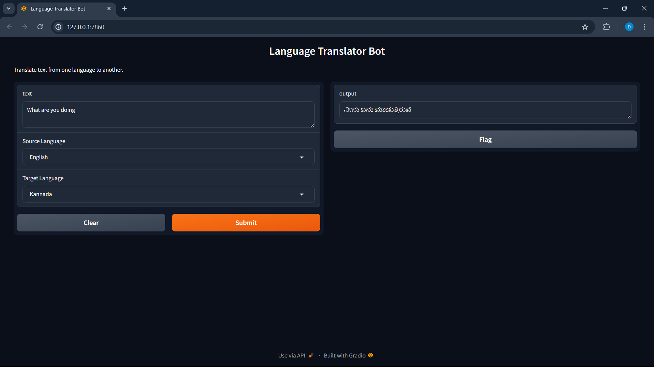
Results :
Department of Artificial Intelligence and Machine Learning www.cambridge.edu.in

Slide 13
Conclusion:-
The development of a language translation bot represents a significant advancement in bridging communication gaps across different languages and cultures. The translation bot offers real-time, accurate translations that can be integrated into various platforms including web, mobile apps, and messaging services. The architecture encompasses key components like user interface, bot framework, translation services, and ensuring seamless interaction and high performance.
Department of Artificial Intelligence and Machine Learning www.cambridge.edu.in

Slide 14
Future works :
Add more languages and dialects to cover a broader range of users and regions.
Integrate speech-to-text and text-to-speech capabilities to allow real-time voice translations.
Develop features to customize translations based on user preferences and context, improving relevance and user satisfaction.
Enable offline translation capabilities so users can access translations without needing an internet connection.
Implement advanced security measures to protect user data and ensure privacy.
Department of Artificial Intelligence and Machine Learning www.Cambridge.edu.in

Slide 15
References :
[1] https://github.com/mouuff/mtranslate
[2] Code Llama: Open Foundation Models for Code
arXiv:2308.12950 [cs.CL]
[3] Daniel Jurafsky and James H. Martin, “Speech and Language Processing”, Pearson,2008 [4] Yoav Goldberg,“Neural Network Methods in Natural Language Processing”,
Morgan & Claypool Publishers, 2017
Department of Artificial Intelligence and Machine Learning www.Cambridge.edu.in

Slide 16
THANK YOU
Department of Artificial Intelligence and Machine Learning www.Cambridge.edu.in

